Slide 1
Dispersion for Data-Driven Algorithm Configuration, Online Learning, and Private Optimization
Travis Dick
Joint work with Nina Balcan and Ellen Vitercik
Carnegie Mellon University

Slide 2
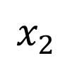
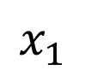
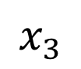
Data-Driven Algorithm Configuration
Problem instances from specific application.
$$x_{1}$$
$$x_{2}$$
$$x_{3}$$
…
Algorithm
Parameters
Output
0.1
0.3
0.2
0.1
1.2
Goal:
Automatically find the best parameters for a specific application domain.
Algorithm is run repeatedly, historic instances are training data.
Want provable guarantees for online and private settings.

Slide 3
An Overview
Algorithm configuration often requires optimizing sums of piecewise Lipschitz functions.
Lipschitz on each piece
Worst-case impossibility results for online and private optimization of PWL functions.
Our Contributions:
Identify a general structural property called dispersion that implies
Good regret bounds in online optimization
Utility guarantees for differentially private optimization
Uniform convergence results in statistical settings.
Satisfied in real problems under very mild assumptions.

Slide 4
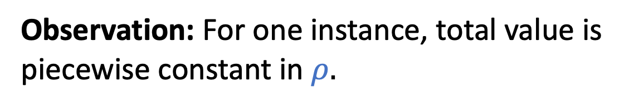
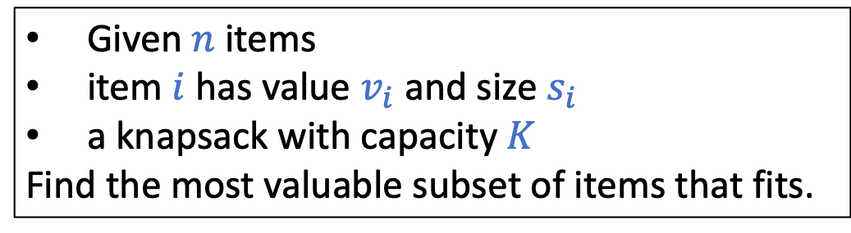
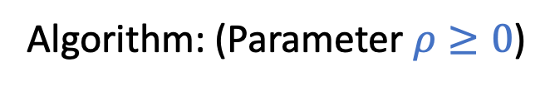
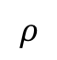
Example: Greedy Knapsack Algorithm
[Gupta & Roughgarden ’16]
Problem Instance:
Given $n$ items
item $i$ has value $v_{i}$ and size $s_{i}$
a knapsack with capacity $K$
Find the most valuable subset of items that fits.
Algorithm: (Parameter $ρ≥0$)
Add items in decreasing order of $score_{ρ}\left(i\right)=v_{i}/s_{i}^{ρ}$.
Observation: For one instance, total value is piecewise constant in $ρ.$
value
$$ρ$$
Order of items fixed.

Slide 5
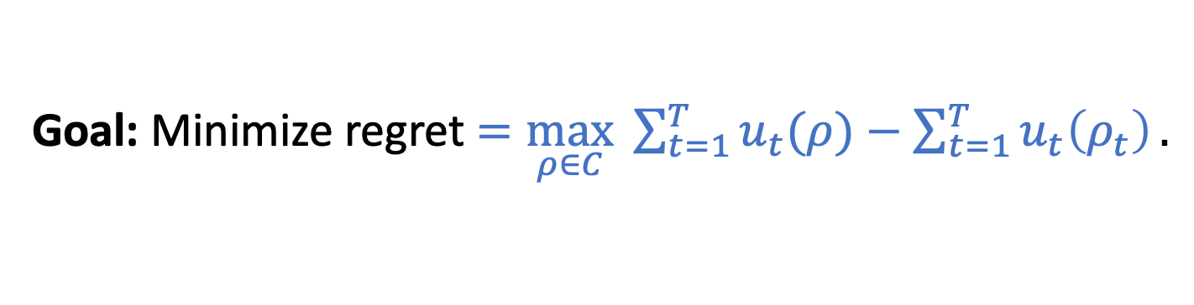
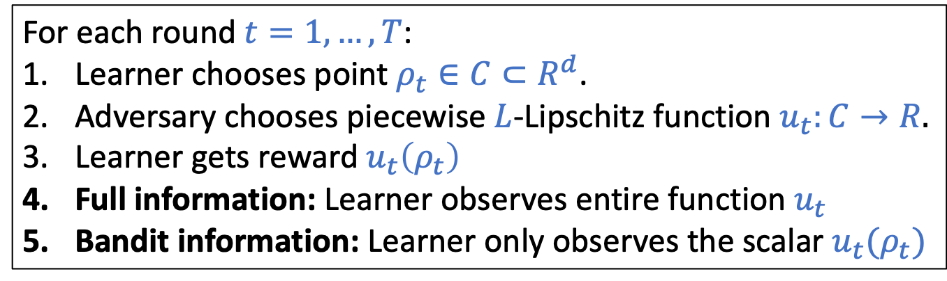
Online Piecewise Lipschitz Optimization
Learning protocol:
For each round $t=1,…,T$:
Learner chooses point $ρ_{t}∈C⊂R^{d}$.
Adversary chooses piecewise $L$-Lipschitz function $u_{t}:C→R.$
Learner gets reward $u_{t}\left(ρ_{t}\right)$
Full information: Learner observes entire function $u_{t}$
Bandit information: Learner only observes the scalar $u_{t}(ρ_{t})$
Goal: Minimize regret $=\max_{ρ∈C} \sum_{t=1}^{T}{u_{t}(ρ)}−\sum_{t=1}^{T}{u_{t}\left(ρ_{t}\right)}.$
[Gupta & Roughgarden ’16] have online algorithms for Max-Weight Independent Set with smoothed adversaries.
[Cohen-Addad & Kanade ’17] consider 1-dim. piecewise constant functions with smoothed adversaries.

Slide 6

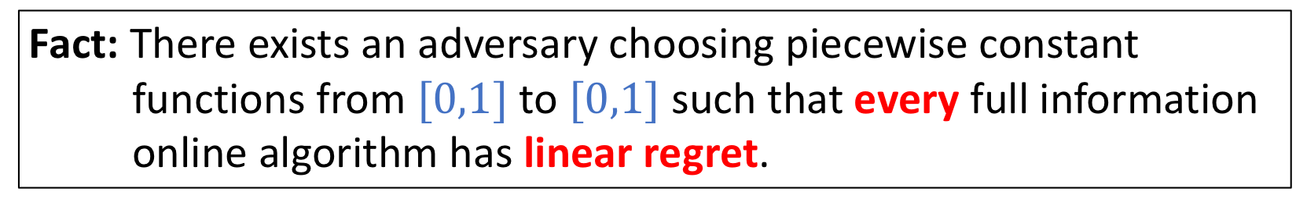
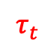
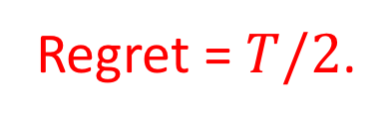



A Mean Adversary
Fact: There exists an adversary choosing piecewise constant functions from $[0,1]$ to $[0,1]$ such that every full information online algorithm has linear regret.
At round $t$, adversary chooses a threshold $τ_{t}$ and flips a coin to choose either
or
$$0$$
$$τ_{t}$$
$$1$$
$$0$$
$$τ_{t}$$
$$1$$
Learner has expected utility of $½$ per round → expected total utility $T/2$.
Let $G_{t}=$ Set of points with payout 1 in first $t$ rounds
Set $τ_{t}$ to be midpoint of $G_{t−1}$ → $G_{T}$ has utility $T$
Regret = $T/2$.

Slide 7
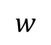
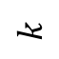
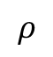
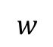
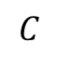
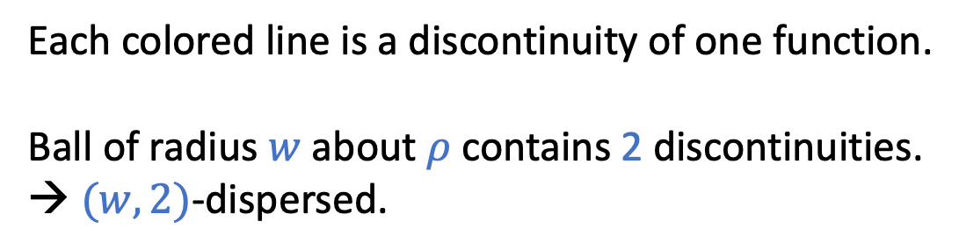
Dispersion
The mean adversary concentrated discontinuities near $ρ^{∗}$. Even very near points had low utility!
Def: Functions $u_{1}\left(⋅\right),…,u_{T}(⋅)$ are $\left(w,k\right)$-dispersed at point $ρ$ if the $ℓ_{2}$-ball $B\left(ρ,w\right)$ contains discontinuities for at most $k$ of $u_{1}…,u_{T}$.
$$C$$
Each colored line is a discontinuity of one function.
Ball of radius $w$ about $ρ$ contains 2 discontinuities.
→ $(w,2)$-dispersed.
$$ρ$$
$$w$$
Functions will satisfy a range of dispersion parameters:
$$k$$
$$w$$

Slide 8
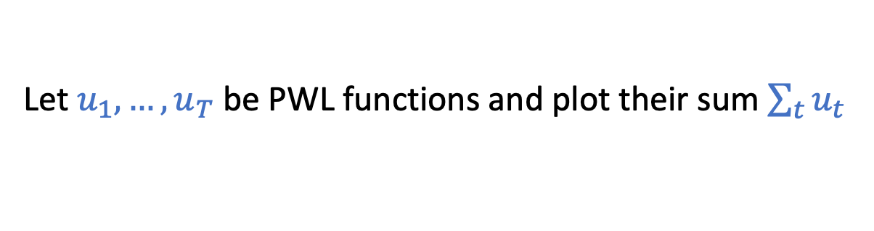
The Sum of Disperse Functions
Let $u_{1},…,u_{T}$ be PWL functions and plot their sum $\sum_{t}{u_{t}}$
Not disperse
Disperse
Many boundaries within interval
Few boundaries within interval

Slide 9

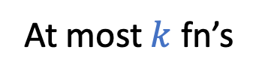

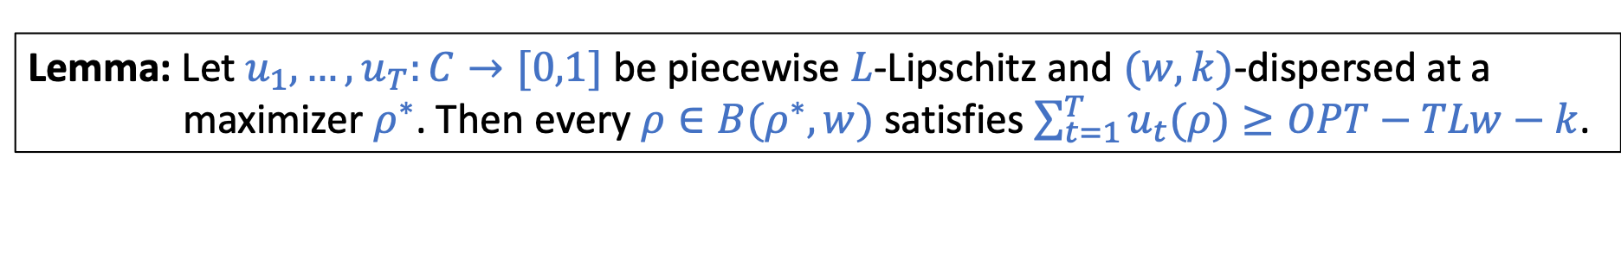
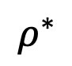
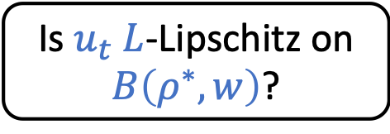
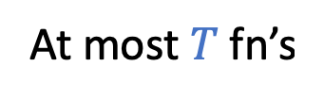
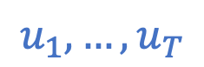
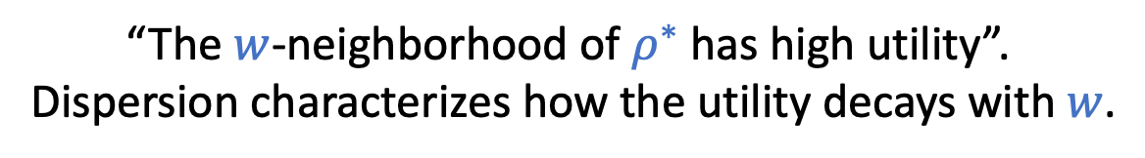
Key Property of Dispersed Functions
Lemma: Let $u_{1},…,u_{T}:C→[0,1]$ be piecewise $L$-Lipschitz and $(w,k)$-dispersed at a maximizer $ρ^{∗}$. Then every $ρ∈B(ρ^{∗},w)$ satisfies $\sum_{t=1}^{T}{u_{t}(ρ)}≥OPT−TLw−k$.
“The $w$-neighborhood of $ρ^{∗}$ has high utility”.
Dispersion characterizes how the utility decays with $w$.
Proof:
$$u_{1},…,u_{T}$$
no
Is $u_{t}$ $L$-Lipschitz on $B\left(ρ^{∗},w\right)$?
yes
$$\left|u_{t}\left(ρ\right)−u_{t}\left(ρ^{∗}\right)\right|≤1$$
$$\left|u_{t}\left(ρ\right)−u_{t}\left(ρ^{∗}\right)\right|≤Lw$$
At most $k$ fn’s
At most $T$ fn’s
$$ρ^{∗}$$

Slide 10
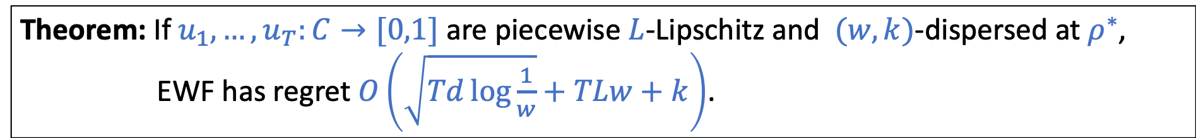
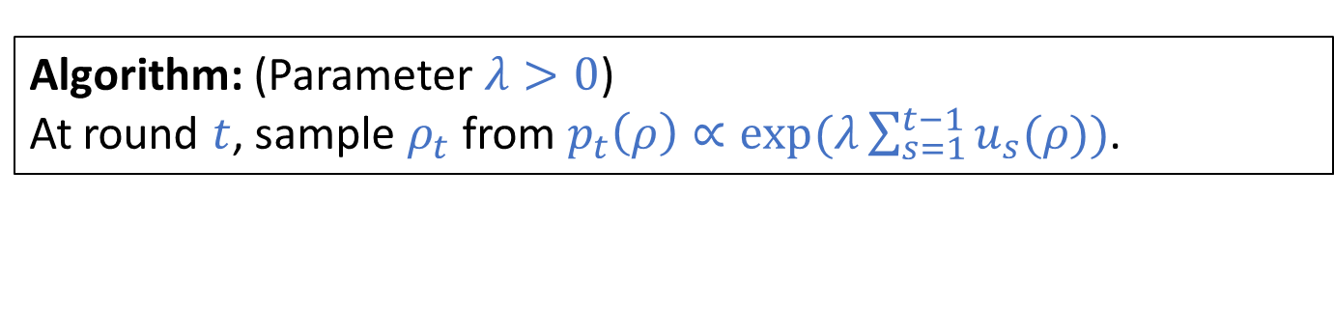
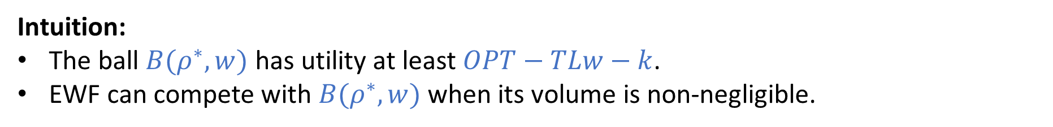
Full Information Regret Bounds
We analyze the classic Exponentially Weighted Forecaster [Cesa-Bianchi & Lugosi ’06]
Algorithm: (Parameter $λ>0$)
At round $t$, sample $ρ_{t}$ from $p_{t}\left(ρ\right)∝exp⁡(λ\sum_{s=1}^{t−1}{u_{s}(ρ)})$.
Theorem: If $u_{1},…,u_{T}:C→[0,1]$ are piecewise $L$-Lipschitz and $(w,k)$-dispersed at $ρ^{∗}$, EWF has regret $O\left(\sqrt{Td\log{\frac{1}{w}}}+TLw+k\right)$.
When is this a good bound? For $w=1/(L\sqrt{T})$ and $k=\tilde{O}(\sqrt{T})$ regret is $\tilde{O}(\sqrt{Td })$.
Intuition:
The ball $B(ρ^{∗},w)$ has utility at least $OPT−TLw−k$.
EWF can compete with $B(ρ^{∗},w)$ when its volume is non-negligible.
$$ρ^{∗}$$
Note: Don’t need to know $(w,k)$ to run algorithm.

Slide 11

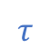
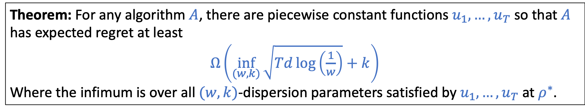



Matching Lower Bound
Theorem: For any algorithm $A$, there are piecewise constant functions $u_{1},…,u_{T}$ so that $A$ has expected regret at least
$Ω\left(\inf_{(w,k)}{\sqrt{Td\log\left(\frac{1}{w}\right)}+k}\right)$
Where the infimum is over all $(w,k)$-dispersion parameters satisfied by $u_{1},…,u_{T}$ at $ρ^{∗}$.
Idea: Calculate dispersion parameters for mean adversary.
or
$$0$$
$$τ$$
$$1$$
$$0$$
$$τ$$
$$1$$
Can make upper bound only tight for $k≥\sqrt{T}$.
Analysis of [G&R ‘16, C-A&K ‘17] both use analysis similar to $(w,1)$-dispersion.

Slide 12


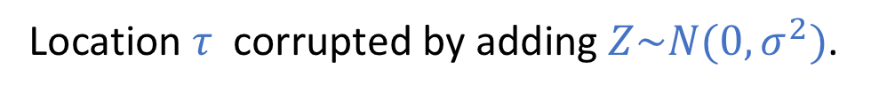
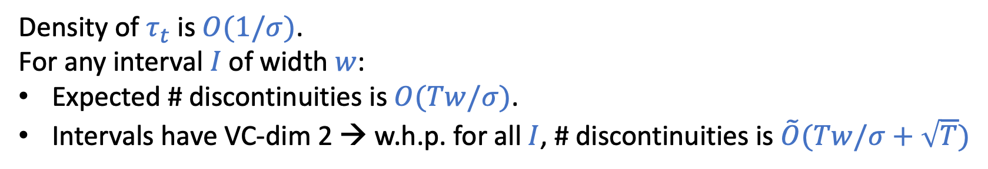
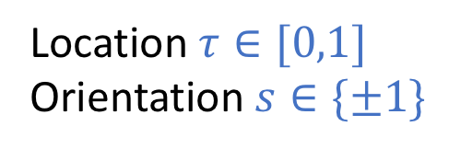
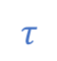
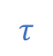
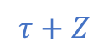


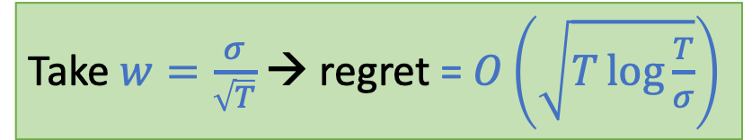
Smoothed Adversaries and Dispersion
Similar to [G&R ’16, C-A&K ’17] we often consider smoothed adversaries.
A simple example:
Consider any adversary chooses threshold functions $u_{1},…,u_{T}:\left[0,1\right]→[0,1]$:
Location $τ∈[0,1]$
Orientation $s∈\{±1\}$
Location $τ$ corrupted by adding $Z\sim N(0,σ^{2})$.
$$0$$
$$τ$$
$$1$$
$$0$$
$$τ+Z$$
$$τ$$
$$1$$
Lemma: For any $w>0$, the fn’s $u_{1},…,u_{T}$ are $(w,k)$-dispersed for $k=\tilde{O}(Tw/σ+\sqrt{T})$ w.h.p.
Density of $τ_{t}$ is $O(1/σ)$.
For any interval $I$ of width $w$:
Expected # discontinuities is $O(Tw/σ)$.
Intervals have VC-dim 2 → w.h.p. for all $I$, # discontinuities is $\tilde{O}(Tw/σ+\sqrt{T})$
Take $w=\frac{σ}{\sqrt{T}}$ → regret = $O\left(\sqrt{T\log{\frac{T}{σ}}}\right)$

Slide 13
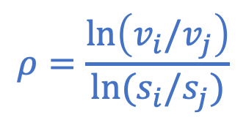
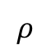
Smoothed Adversaries and Dispersion
More generally: adversary is unable to precisely pick some problem parameters (e.g. item values in knapsack).
Challenges:
Each utility function has multiple dependent discontinuities.
Distribution of discontinuity location depends on setting.
How do we generalize to multiple dimensions?
$$ρ=\frac{\ln\left(v_{i}/v_{j}\right)}{\ln{(s_{i}/s_{j})}}$$
value
$$ρ$$
Dispersion decouples problem-specific smoothness arguments from regret bounds, differential privacy utility guarantees, and uniform convergence.

Slide 14

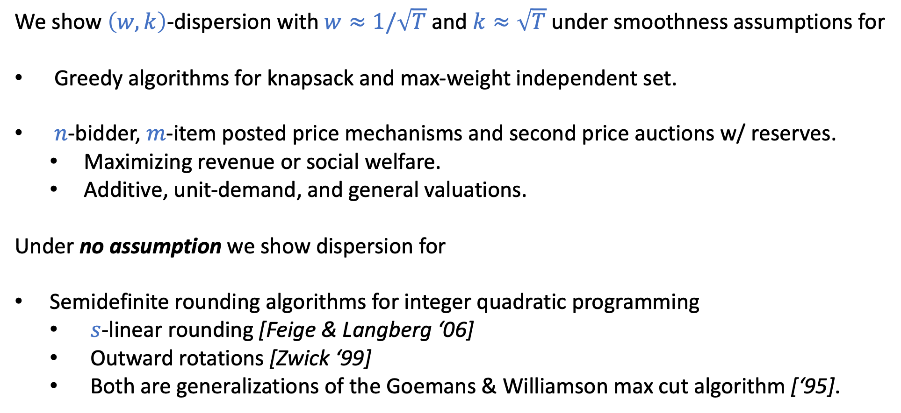
Dispersion in Algorithm Configuration and Pricing
We show $\left(w,k\right)$-dispersion with $w≈1/\sqrt{T}$ and $k≈\sqrt{T}$ under smoothness assumptions for
Greedy algorithms for knapsack and max-weight independent set.
$n$-bidder, $m$-item posted price mechanisms and second price auctions w/ reserves.
Maximizing revenue or social welfare.
Additive, unit-demand, and general valuations.
Under no assumption we show dispersion for
Semidefinite rounding algorithms for integer quadratic programming
$s$-linear rounding [Feige & Langberg ‘06]
Outward rotations [Zwick ‘99]
Both are generalizations of the Goemans & Williamson max cut algorithm [‘95].

Slide 15
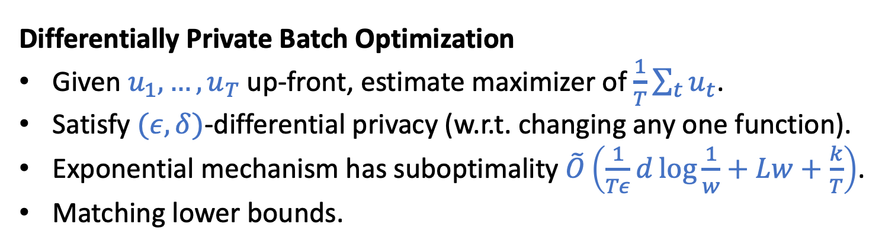
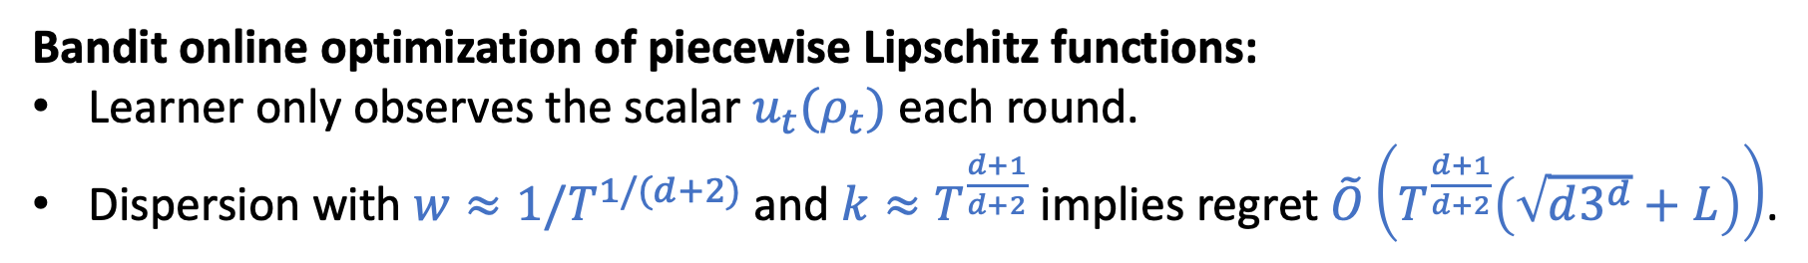
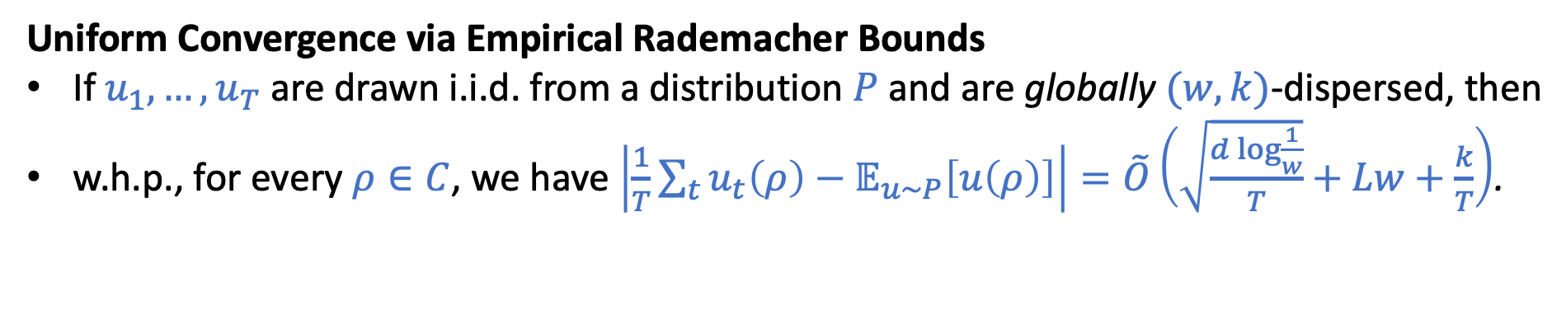
More Results from Dispersion
Bandit online optimization of piecewise Lipschitz functions:
Learner only observes the scalar $u_{t}(ρ_{t})$ each round.
Dispersion with $w≈1/T^{1/(d+2)}$ and $k≈T^{\frac{d+1}{d+2}}$ implies regret $\tilde{O}\left(T^{\frac{d+1}{d+2}}\left(\sqrt{d3^{d}}+L\right)\right)$.
Differentially Private Batch Optimization
Given $u_{1},…,u_{T}$ up-front, estimate maximizer of $\frac{1}{T}\sum_{t}{u_{t}}$.
Satisfy $(ε,δ)$-differential privacy (w.r.t. changing any one function).
Exponential mechanism has suboptimality $\tilde{O}\left(\frac{1}{Tε}d\log{\frac{1}{w}}+Lw+\frac{k}{T}\right)$.
Matching lower bounds.
Uniform Convergence via Empirical Rademacher Bounds
If $u_{1},…,u_{T}$ are drawn i.i.d. from a distribution $P$ and are globally $(w,k)$-dispersed, then
w.h.p., for every $ρ∈C$, we have $\left|\frac{1}{T}\sum_{t}{u_{t}\left(ρ\right)−𝔼_{u∼P}\left[u\left(ρ\right)\right]}\right|=\tilde{O}\left(\sqrt{\frac{d\log{\frac{1}{w}}}{T}}+Lw+\frac{k}{T}\right)$.

Slide 16
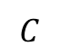
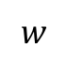
Conclusions & Open Questions
Introduced dispersion, which measures concentration of discontinuities of PLW fns.
Dispersion-based regret bounds for online optimization of PWL functions.
Utility guarantees for differentially private optimization.
Uniform convergence in statistical settings.
Examples of dispersion in real problems.
$$C$$
Not disperse
Disperse
$$ρ$$
$$w$$
Open Questions:
Dispersion-like definitions for other types of bad properties beyond discontinuities.
Algorithm configuration is between full-info and bandit feedback. Can we take advantage?
More refined algorithms for bandit online optimization.

Slide 17
Thanks!

